Slide 1

OCC Compliance Policy
and
Office of the Ombudsman
The NAACP Western Region I
Civil Rights Advocacy Training Institute
Economic Empowerment Breakfast
Saturday, May 5, 2007

Slide 2

Compliance Policy Division
Organizational Structure
Primary Function
Secondary Function

Slide 3
Primary Function
Expert Advice to OCC Executive Management
Examination Development and Guidance
Examination Support
Systemic Analysis of Key Issues

Slide 4
Secondary Function
Interagency Coordination
Examiner Training and Development
Industry Outreach
External Representations

Slide 5
Types of Examinations
Community Reinvestment Act
Fair Lending
Consumer Lending Regulations
Consumer Deposit Regulations
Other Regulations

Slide 6
Examination Outcomes
Community Reinvestment Act Public Evaluations
Reports of Examination
Other Communication Methods
Periodic Examination Follow-up

Slide 7
Consumer Input
Community Reinvestment Act – Comment Letters
Corporate Application Process – Comment Letters
Home Mortgage Disclosure Act – Review of Public Data

Slide 8
Tools You Can Use
www.occ.treas.gov
www.ffiec.gov
www.occ.treas.gov/customer.htm
www.google.com

Slide 9
Office of the Ombudsman

Slide 10
Mission Statement
The Ombudsman’s office is organized around core principles of dispute resolution and customer service. The office seeks to ensure that national banks and customers of national banks receive fair and expeditious resolution of their complaints through two distinct units within the office:
Customer Assistance Group
National Bank Appeals Process

Slide 11
Office of the Ombudsman
National Banks
OMBUDSMAN
Public
OCC
Customer-Focused
Other Engaged Parties

Slide 12
The OCC’s Office of the Ombudsman
What We Do
National Bank Appeals Process
Customer Assistance Group
How the OCC Uses Consumer Complaints
Supervisory Process
Guidance to the Industry
Enforcement Authority
Top Issues for Consumers
Credit Cards
Checking Accounts
Home Mortgages

Slide 13
CAG Technology
Continual Improvement of Products & Services
Automated telephony & call routing to English & Spanish
queues
Imaging of all
documents
State-of-the-Art Case Management System (Remedy)
Web-based G2BComplaint Delivery System (CAGNet)
Web-based Supervisory Tools (CAGWizard)
Digital recording of all telephone conversations
A 24-hour, 365 days a year Internet access
Quality Assurance Program

Slide 14

Complaints Are An Opportunity
Complaints can serve as an early warning system for potential problems.
Rising complaint volume may be an indicator of risks:
Compliance
Strategic
Transaction
Reputation

Slide 15
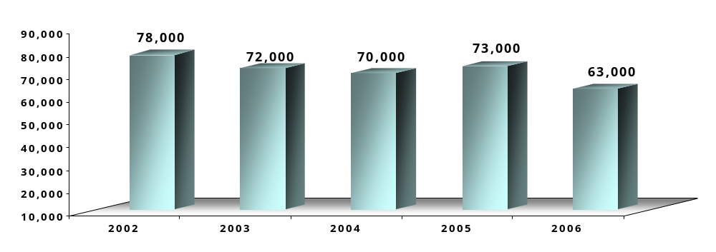
Case Processing Volumes

Slide 16
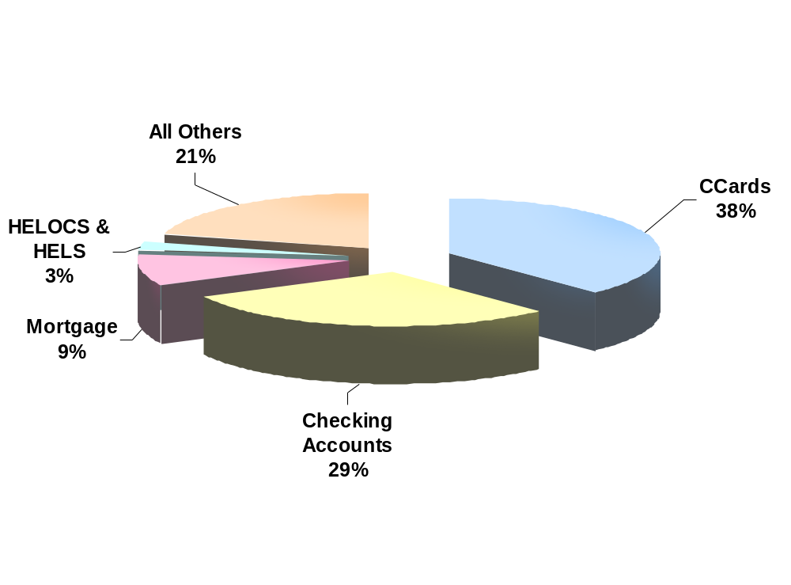
Complaints by Major Product Type 2006
HELOCS & HELS (Home Equity Lines of Credit & Home Equity Loans)
CCards (Credit Cards)

Slide 17
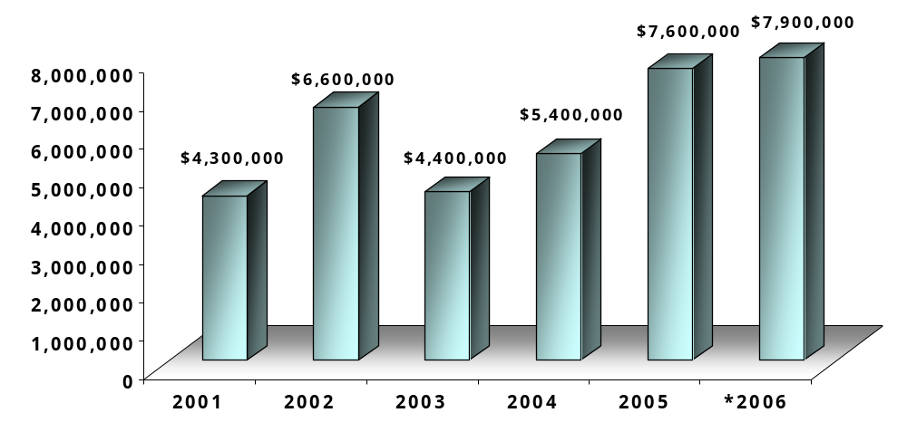
*Fees and Charges Returned to Customers
*Information based upon Complaint Closed Date

Slide 18
Customer Assistance Group
Assists customers of national banks and operating subsidiaries of national banks who have complaints related to applicable banking laws and regulations
Provides informal consumer education on banking
Facilitates communication between the bank and its customers

Slide 19
OCC’s Office of the Ombudsman
Mailing Address
1301 McKinney Street
Suite 3450
Houston, TX 77010
Phone
800-613-6743
713-336-4300
713-336-4351 (fax)
Internet
www.occ.treas.gov
E-mail
customer.assistance@occ.treas.gov
Samuel.Golden@occ.treas.gov or Craig.Stone@occ.treas.gov

Slide 20
Questions from the Group

Slide 21
Appendix

Slide 22
Examples of Regulatory Guidance Issued in Response to Consumer Complaints
Anti-Predatory Lending
Guidance 12 CFR 34.3
Guidance on Unfair or Deceptive Practices
AL 2002-3
Interagency Guidance on Overdraft Protection
AL 2005-18
Credit Card Lending Account Management
AL 2003-1
Service Members Civil
Relief Act
AL 2004-8
Unauthorized Transfers
(EFT)
AL 2001-9
Credit Card Repricing and Promotional Rates
AL 2004-10
Secured Credit Card Lending Guidance
AL 2004-4

Slide 23
Staff Profile
CAG is comprised of more than 70 compliance professionals including:
  9 national bank examiners
  15 certified regulatory compliance managers
  1 certified risk professional
  1 certified internal auditor
  1 individual with a law degree
Our staff is comprised of consumer compliance and bank
operations professionals or individuals with previous experience in
Bank Supervision. The majority of the staff join us from major bank
Companies, such as JPM Chase, Bank of America, Citibank, American
Express, Washington Mutual, Wachovia, and Wells Fargo.

Slide 24
CAG Organizational Chart
Sam Golden
Ombudsman
Maria Olguin
Senior Advisor Ombudsman
Craig Stone
Deputy Ombudsman Customer Assistance
Pat Limbrick
Executive Assistant
OPEN
Quality Assurance Manager
Barbara Maurice
Secretary
Glenna Shaw
Information Systems Manager
Sherry Resler
Projects Analyst
Kathy Kaplan
E-Biz & Customer Services Mgr
Valare Blewett
NBE - Senior Analyst
Mendy Goodnight
Complaint Operations Manager
OPEN
E-Biz Analyst
Alice Jones
NBE - Analyst
Dennis Magro
NBE - Analyst
Mike Demerle
NBE – Analyst
Nancy Wells
Customer Service Manager
Debbie Baker
Customer Service Manager
Deidra Chandler
Customer Service Manager
Angela Resby
CAGNet Specialist
Mary Hagardt
CAGNet Specialist
Marvin Cure
CAGNet Specialist
Rhonda McCausland
CAG Team Leader
Laura Beimer
CAG Team Leader
Angela Willis
CAG Team Leader
CAG Specialists
CAG Specialists
CAG Specialists

Slide 25
Complaint Life Cycle
Initial
Contact
Phone, mail, fax
or E-mail
Receipt of
Complaint
Written with customer’s
signature
Document
Scanning
Unique case is created and
documents are added.
Initial
Review
Specialist reviews issue to
ensure proper authorization,
bank assignment, etc.
Case is set to transfer to
bank via CAGNet.
Review Bank
Response *
Case sent to CAG for resolution.
Specialist reviews the response.
Case could be closed at this point
or sent back to the bank for
additional information.
Final Review
Case Closing
Specialist reviews any
subsequent information
provided by the bank and/or
additional information
from consumer. In cases involving
technical legal interpretations,
counsel and guidance are provided
by OCC Chief Counsel’s Office.
Review w/
Supervision
As needed or as part of the annual
presentation to bank management
Complaint
Analysis
Conducted by CAG Analyst,
Team Manager, Supervisory staff
*Are the bank’s actions consistent with applicable laws and regulations?
*Was the customer treated fairly?
*Bank customers who disagree with our findings may appeal to the Deputy Ombudsman.

Slide 26
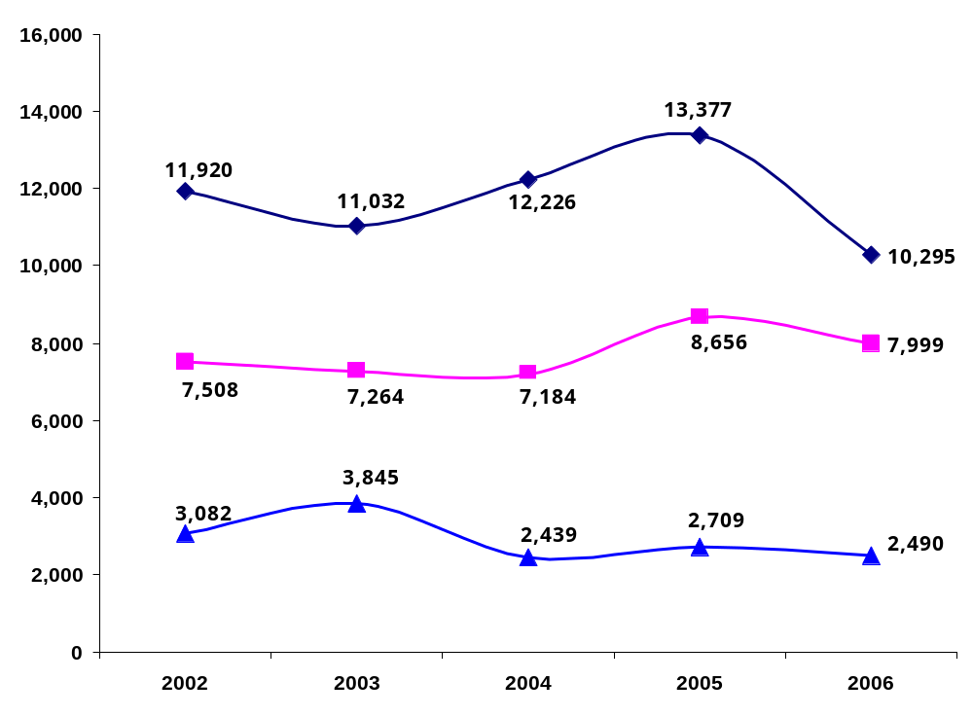
Selected Products with Significant Complaint Volume

Slide 27
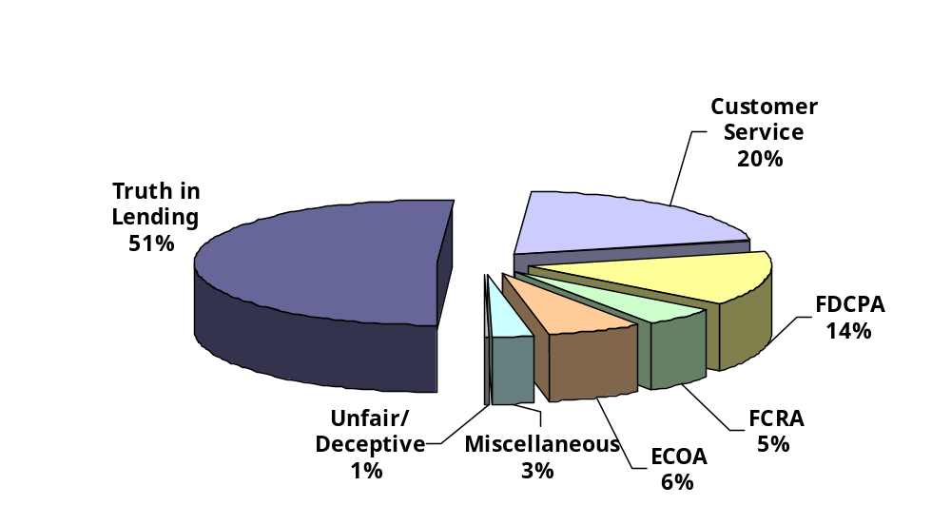
Distribution of Credit Card Complaints 2006
FDCPA (Fair Debt Collection Practices Act)
FCRA (Fair Credit Reporting Act)
ECOA (Equal Credit Opportunity Act)

Slide 28
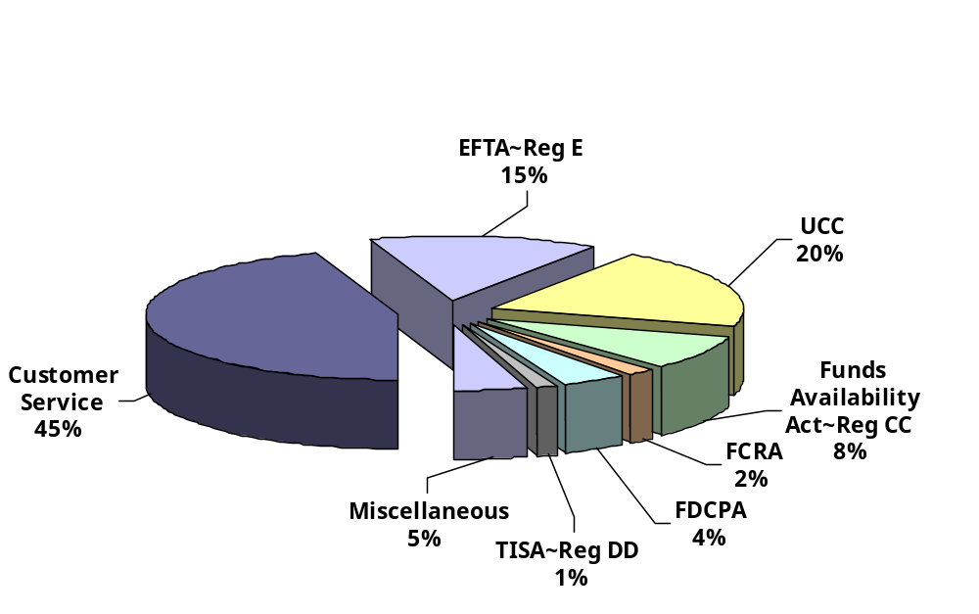
Distribution of Checking Account Complaints 2006
EFTA - Reg E (Electronic Fund Transfer Act and Regulation E)
UCC (Uniform Commercial Code)
FCRA (Fair Credit Reporting Act)
FDCPA (Fair Debt Collection Practices Act)
TISA - Reg DD (Truth in Savings Act - Regulation DD)

Slide 29
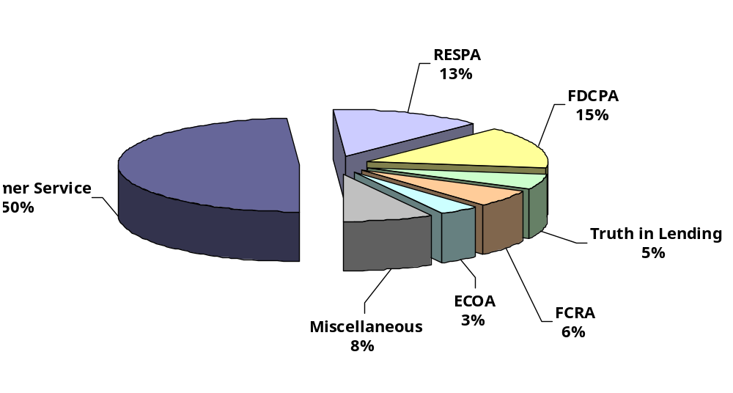
Distribution of Mortgage Complaints 2006
Customer
Service
50%
RESPA (Real Estate Settlement Procedures Act)
FDCPA (Fair Debt Collection Practices Net)
FCRA (Fair Credit Reporting Act)
ECOA (Equal Credit Opportunity Act)

